Slide 1


Slide 2
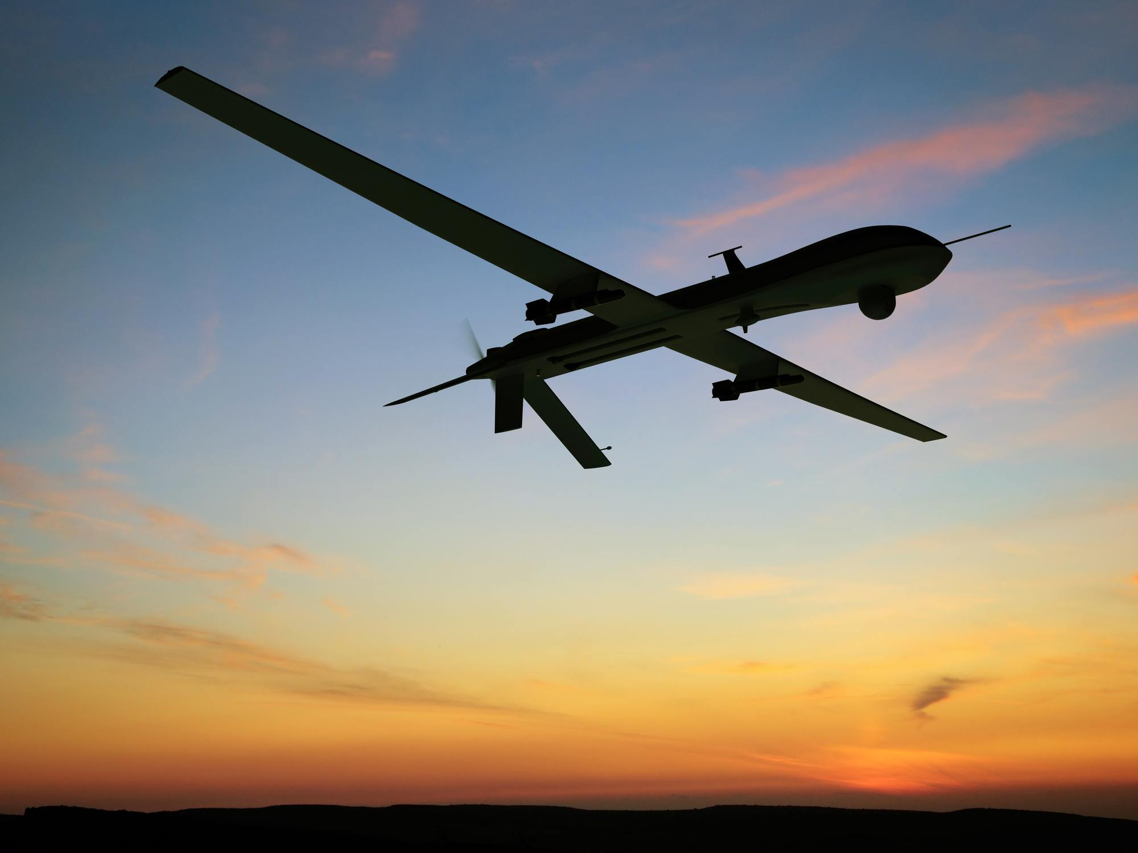
DRONE IN DEFENCE
OUR TEAM
*Priyanka
*Vinayak
*Abhishek
*Samarth
*Joel

Slide 3
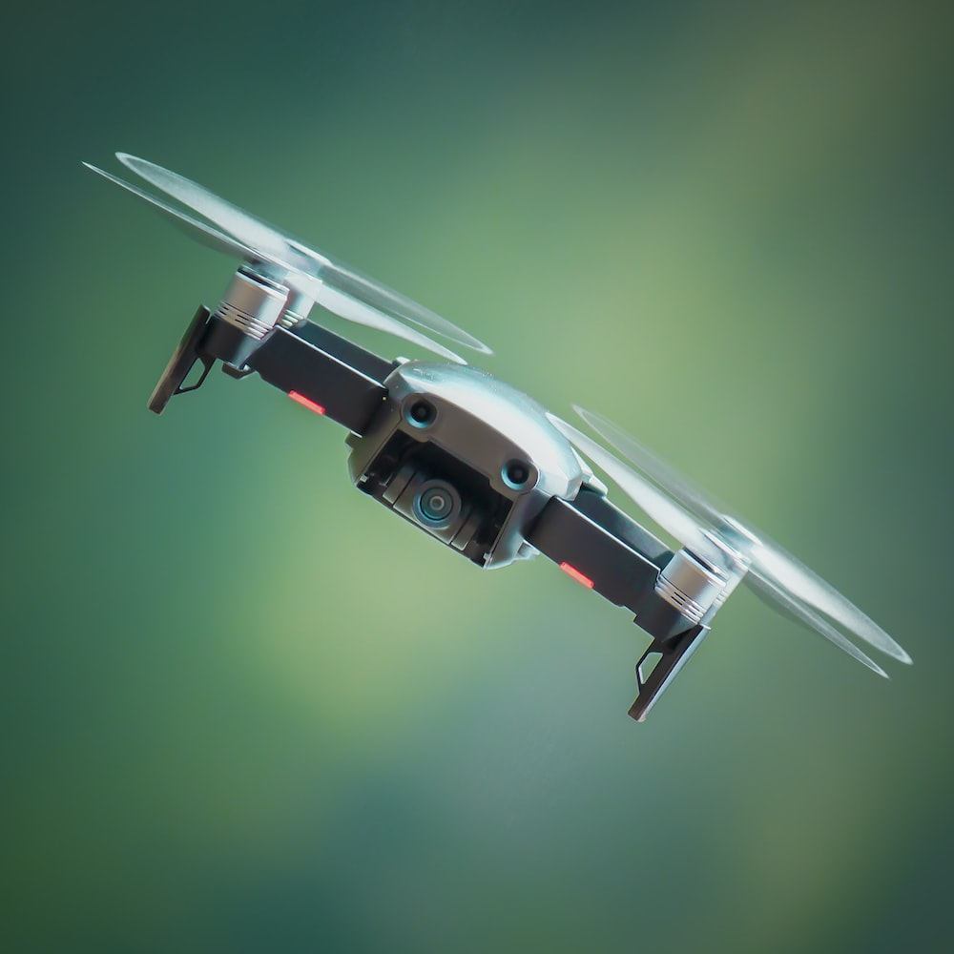
1. Plastic
Plastic is easy to mold into solid objects of different sizes and shapes. Lighter than metal alloys, plastic has high malleable properties and offers high resistance to corrosion and chemicals. I
2. Aluminum Alloys
Aluminum is a common metal used to construct drone airframes.
3. Composites
Compared to aluminum, composites reduce weight by 15-45%. Besides high strength, composites are resistant to corrosion from saltwater and electrolysis.
1. Plastic
Plastic is easy to mold into solid objects of different sizes and shapes. Lighter than metal alloys, plastic has high malleable properties and offers high resistance to corrosion and chemicals. I
2. Aluminum Alloys
Aluminum is a common metal used to construct drone airframes.
3. Composites
Compared to aluminum, composites reduce weight by 15-45%. Besides high strength, composites are resistant to corrosion from saltwater and electrolysis.
1. Plastic
Plastic is easy to mold into solid objects of different sizes and shapes. Lighter than metal alloys, plastic has high malleable properties and offers high resistance to corrosion and chemicals. I
2. Aluminum Alloys
Aluminum is a common metal used to construct drone airframes.
3. Composites
Compared to aluminum, composites reduce weight by 15-45%. Besides high strength, composites are resistant to corrosion from saltwater and electrolysis.

Slide 4
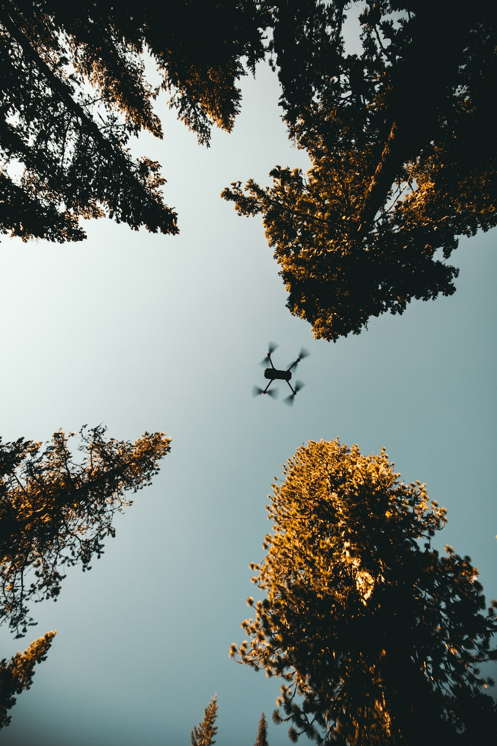
Power supplies :
There are different power sources for a drone, including battery, solar, hydro fuel cell, combustion engine, cable-tethered power supply and laser beam power. The most common source of power is a lithium-polymer battery.

Slide 5
Actuators and motors :
These include digital electronic speed controllers linked to engines, propellers, servomotors and others.
Sensors
Various sensors are used in a drone as per requirement and application. Position and movement sensors give information about the state of the aircraft. Common sensors are laser, radar, camera, gyroscope, accelerometer, compass, barometer and GPS receiver.
Computing
Drones use advanced computing technology, from analogue controls to microcontrollers, systems-on-chip and single-board computers.
Software

Slide 6
Software :
Flight stack or autopilot software are used in drone applications. Open source software like Openpilot and others are easily available.
Also, there are many smartphone apps available for drones.
Remote control :
Most drones use radio frequency to communicate between the remote and the drone, which may be capable of autonomous or semi-autonomous operations. Remote control signals from the operator side can be issued from one of the following:

Slide 7
Ground control, which is a human operating a radio transmitter, smartphone, computer or other similar control system.
Remote network system, like satellite duplex data links, cellular mesh and LTE network.
Another aircraft serving as a relay or mobile control station.

Slide 8
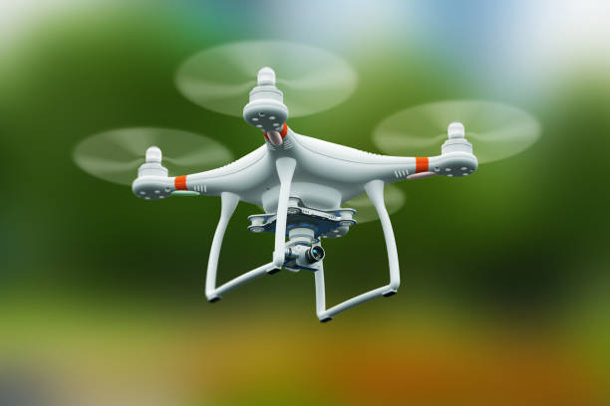
TECHNOLOGY USED IN DRONES
An airborne drone is a device that does not require a pilot on board , it is also called an unmanned arial vehicle (UAV).
Drone technology is something that is continually evolving, with investments in it increasing year by year. This is because drones have a wide range of uses that are crucial for several industries. For example, unmanned aerial vehicles are commonly used in the military for gathering intelligence, for anti-aircraft target practice and more.
Drones can be equipped with sensors, including ultrasonic, laser or lidar distance sensors, time-of-flight sensors, chemical sensors, and stabilization and orientation sensors. Visual sensors offer still and video data.

Slide 9
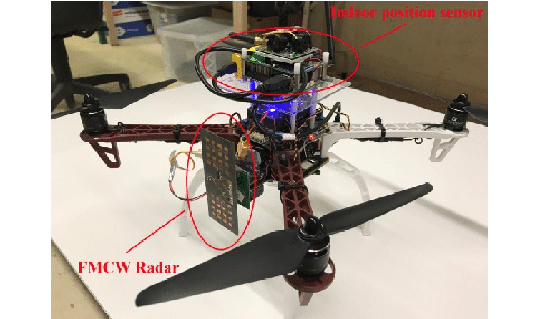
Radar positioning and return home
Modern drones are integrated with dual Global Navigational Satellite Systems or GNSS, which includes GPS and GLONASS.
These drones can fly in GNSS as well as non-satellite modes.
Radar positioning helps in accurate drone navigation and also displays the current position of the drone in relation to the controller.
The Return to Home feature guides the drone back to the controller.

Slide 10
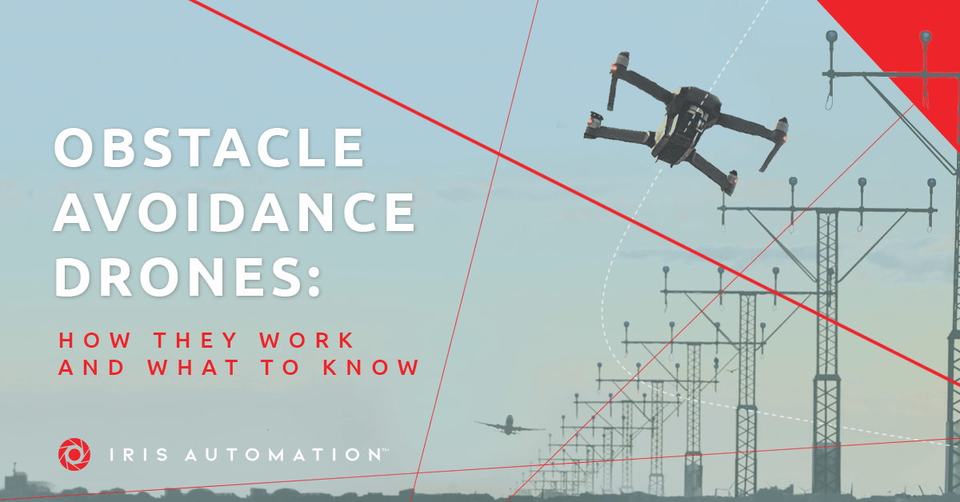
Obstacle detection and Collision avoidance technology
High-tech drones come with obstacle detection and collision avoidance technology in order to ensure safety.
These sensors thoroughly scan the surrounding environment, while SLAM technology and software algorithms produce the scanned images into a 3D map.
These are technologies which enable the drone to move into the air and hover, or fly in any direction. They let the drone either hover or fly based on the data received from the flight controller and electronic speed controllers.

Slide 11
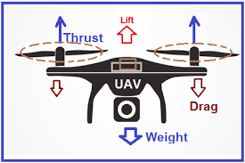
WORKING PRINCIPLE OF DRONES
High fluid pressure at the bottom and low pressure at the top of the propeller causes an upward force which is called a lift.
This force is responsible for lifting the weight of an aero-plane or drone.
The amount of lift force depends on the angle of inclination of the aerofoil or propeller.

Slide 12
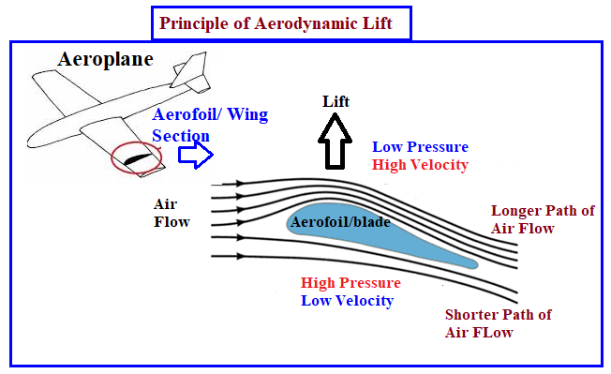
WORKING PRINCIPLE OF DRONES
A sufficient amount of upward force is required to lift the vehicle against gravity which is named lift.
A force created to move the vehicle or body in motion is called thrust. These forces can be studied using the kinematic laws of fluid flows.
When air flows over an aerofoil and pressure, viscous and drag force act on the profiles.
Finally the drone get started to achieve the objective.

